Slide 1

Design Digitaler Schaltkreise
Place and route 1
Prof. Ivan Peric ivan.peric@kit.edu
Richard Leys richard.leys@kit.edu

Slide 2
Lecture Goal
Get an overview of place and route steps
Understand floorplaning steps to prepare top level
After that: Ready to go for final implementation
Talk about timing later

Slide 3
Place and Route Goal
After Synthesis, we have gates and interconnection information
Physically place the circuit to create an ASIC
Gates
Floorplan
Place
Special Routes
Clock Tree
Route
GDSII
Layout vs Schematic + DRC

Slide 4
P&R Strategy
Try to create the best conditions for an easy implementation
Ex: Not too big (long wires), Not too small (less optimisation freedom)
But take into account the design constraints, like embedded special blocks (PLL, Memories, Test controllers), cost etc
Let the software perform as much automated work as possible
Timing is checked the whole time
  Each step have small adjustment steps to improve timing

Slide 5
Floorplaning Overview
Prepare the design for physical implementation: set the foundations
The best the floorplaning, the less effort required by automated tasks
Usually heavily scripted because a lot of small components must be added to the design for physical rules
  If any re-synthesis is necessary, just re-run the script
During floorplaning:
  Prepare the die dimensions
  Prepare the I/O
  Pre-Place hard macros
  Route special wires
  Create Partitions (if necessary)
  Add spare cells, well tap etc…
  Ready to continue!

Slide 6



Die Size Configuration
Core Die Area
Size constraint:
  Cost
  Technical limitation (Multi layer Mask)
  Minimal size sometimes:
  I/O bound: Too many pins
  Core bound: Too much logic
Core Area Bound
I/O Bound

Slide 7
I/O Placement and Pads
I/O provide interface to external world
In smaller technology node, there is an IO voltage:
  UMC65: 1.8 V for IO typically, ~1V for core logic
I/O cells are big and provide voltage translation, as well as ESD protection
Like Standard cells, they are designed to be abutted to each other
PAD side (outside)
VDD
Standard height
Power rails
VSS
Core side (inside)

Slide 8
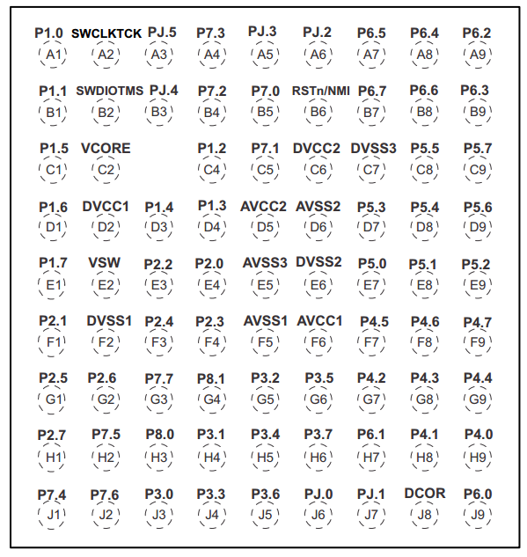
Power Domains and IO
Power Domains are used to separate various supplies:
  Typical: Analog and Digital Domains
  Possible: Multiple digital power domains
Explanation:
  Digital and Analog are separated to avoid power supply cross-talk
  A digital domain can have a lower VDD to save power, and another one a higher VDD for better performances
Advanced options:
  Digital Power domains can interface using level shifters placed by the tool
  Digital Power domain can be “shutdown”; like a sleep mode
TI MSP432 Microcontroller PADS

Slide 9
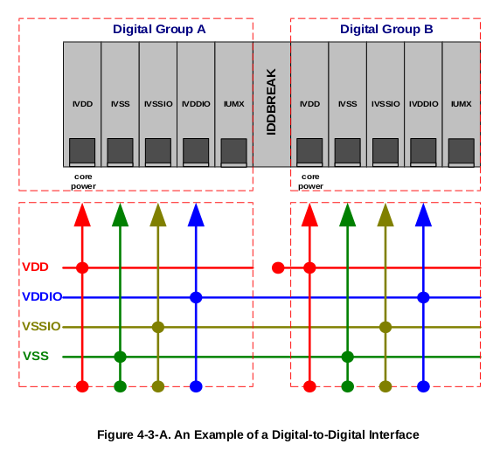
IO Power rows design
IO Cells have specific rules for power rail connections
The Technology documentation provide information
Design by abutment, power rails must respect some rules:
All power domains must be separated
Required cells
IUM#: Signal cell
Example from UMC65: Multiple Digital Domains

Slide 10
IO Placement types
Area I/O
IO cells can be placed:
  outside the core area: Ring IO
  Inside the core area: Area I/O
    If design is big, it gives more freedom
Connection PADS can be placed:
  around the die: PADS for wire bonding
  on the area for flip-chip connection
I/O Ring
Core site

Slide 11
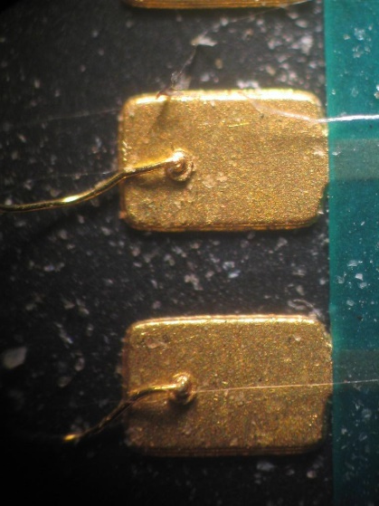

PAD type: Wire Bonding Pads
Connection PADS can be around the core, with AREA IO or not
Die
core
PCB
Package (ex: QSFP)

Slide 12
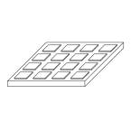
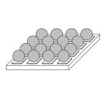
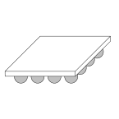
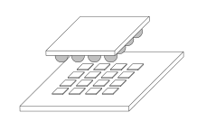
PAD type: AREA IO for Flip-Chip
Area IO and Bumps are used for Flip-Chip mounting
Bump to IO Cell is routed over a Redistribution Thich Metal layer
Bump
die
package

Slide 13
ASIC
Wire Bond

Slide 14
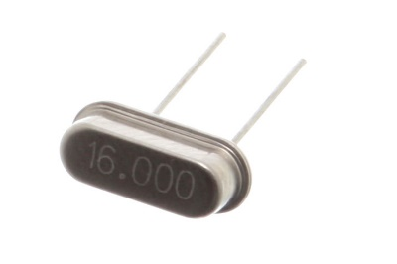

IO Cell Types
IO Cells can be of various types, depending on the technology library
Standard types:
  Power Connections: VDD,VSS,VDDIO,VSSIO
  Fillers: FILLER1, FILLER10, CORNER
  Signal Cell for Digital/Analog Signals
Special Cells:
  Differential Signal (ex: LVDS), Oscillator cells etc…
power
clk
signal
fillers
Special Cells example: Oscillator

Slide 15
Partitioning: Definition and re-implementation
Partitions are used to cut-off the design in smaller subset
Each Subset is synthesised and implemented separately.
The top level prepares IO Placement between partitions
Final timing is done at top level with last adjustments
IO are planned
P1
P3
P3
P2
Final: “Injection”
Top level
Partition Level: Full Implementation
empty

Slide 16
Partition Level implementation
Like top level but constraints and IO are provided
Proceed to normal implementation
Leave topmost layers in technology for top level connections
clk
Partition Layers strategy example
9 + RDL
Reserved
8
Ex: power
7
2-6
Clock & Routing
1
Partition Base Design

Slide 17
Hard Macros
Hard Macros are like partitions, but ready to use
LEF file provides size and IO information
Most common cases:
  SRAMS
  PLL
  Temperature sensor
Place objects as any other
RAM
RAM
RAM
RAM
Sometimes design have many rams

Slide 18
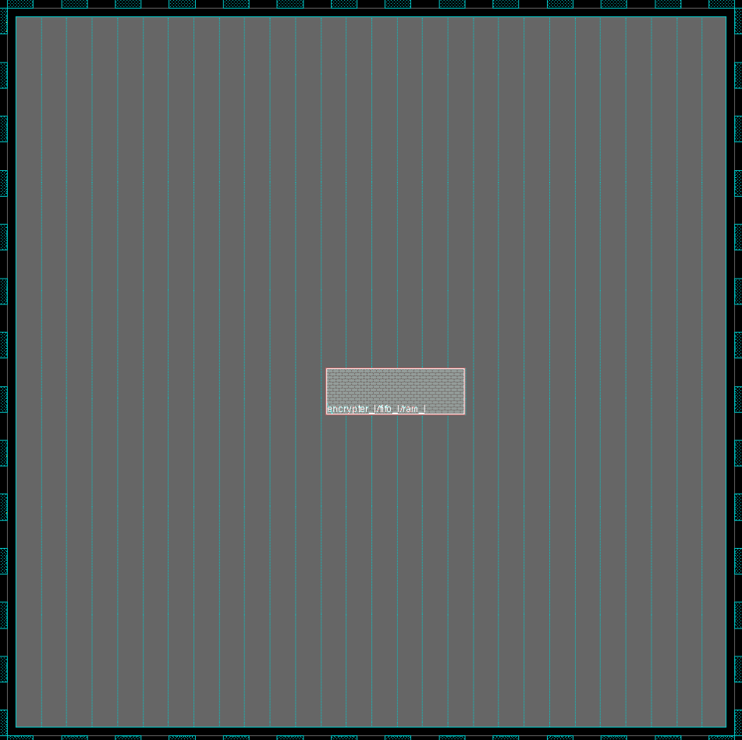
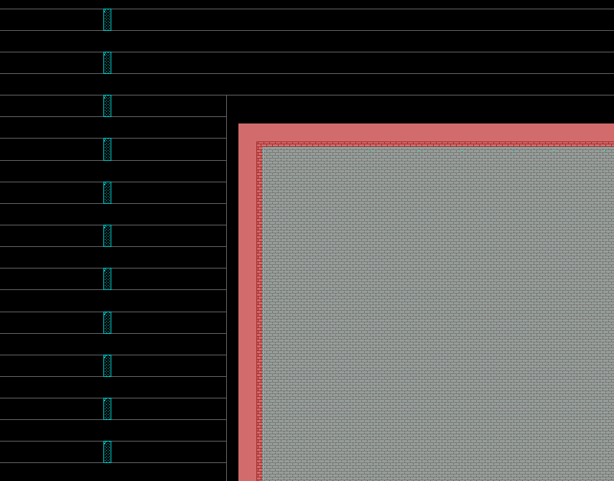
Pre-Placement : Finish floorplan
Cut the Rows to leave space around the hard macros
Add specifics like Well-Taps: See Technology documentation
Well Tap Cells
No row

Slide 19
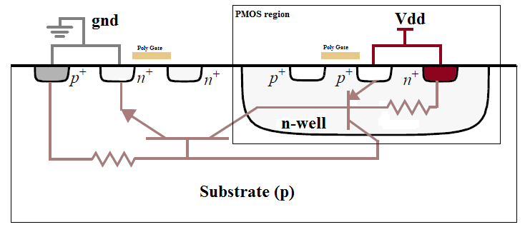
Pre-Placement: WellTap example
Latchup: VDD/GND short due to parasitic BJT
Prevent Latchup: Require enough Well contacts to keep Rsub low
See Technology documentation
Links to read:
http://www.analog.com/library/analogDialogue/archives/35-05/latchup/index.html
http://www.ece.drexel.edu/courses/ECE-E431/latch-up/latch-up.html
Well Tap
Well Tap
Rsub(n)
Rsub(p)
https://en.wikipedia.org/wiki/Latch-up

Slide 20
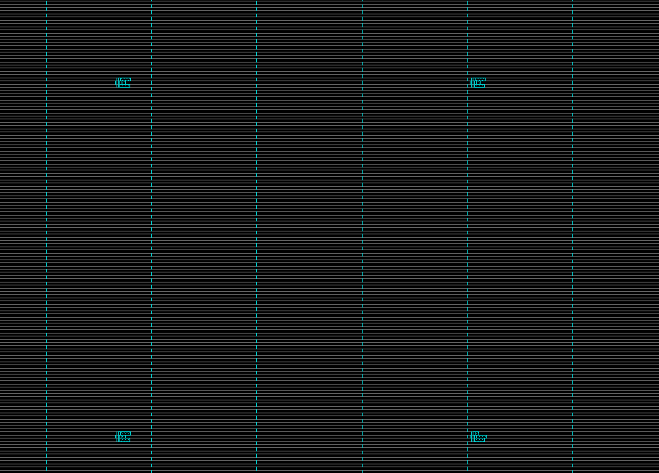
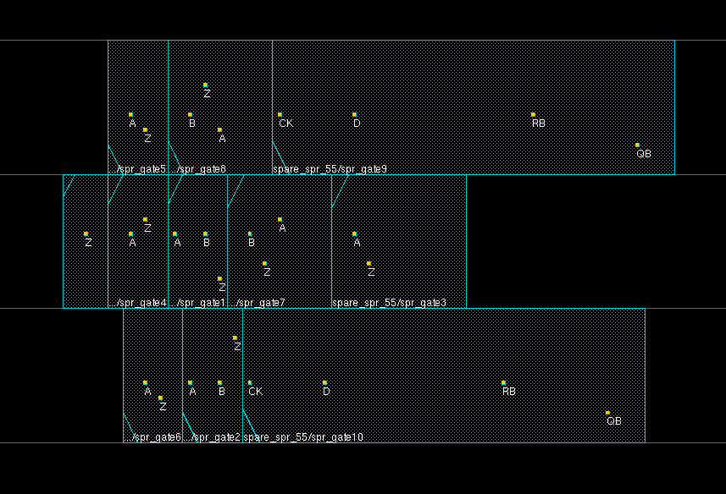
Pre-Placement: Spare Cells example
Some clusters of cells can be added on the core area for latter fixes.
The production masks can be slightly modified to fix an issue. The spare cells can be used to modify the logic a bit.

Slide 21
Placement in the Tools
How does placement happen in the tools?
Standard cell placement – see later
Manually Create Instances for special cells
Place with coordinates
  placeInstance 100 200 $ram
The tools sometimes have special commands to place extra structures:
  Typically: Fillers

Slide 22
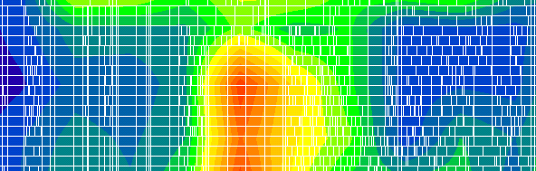
Power planning and Power Analysis
Power connections are important
  If not enough of them the voltage drop across the design can be huge: IR drop picture
Problem: Functional Power analysis are not simple, runtimes are long
Solution: Add as much as you can
IR Drop example
Source: semiwiki.com

Slide 23
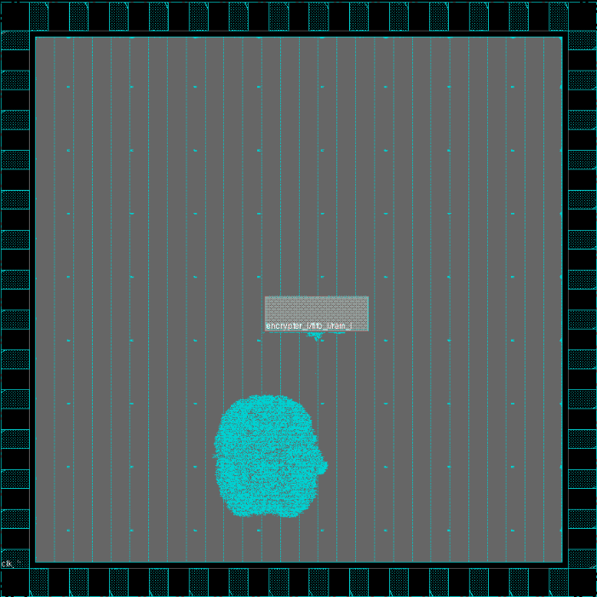
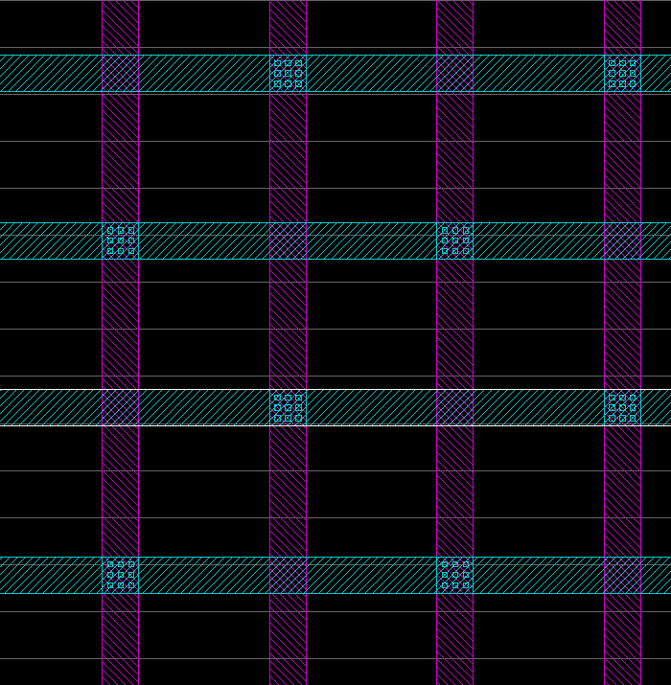
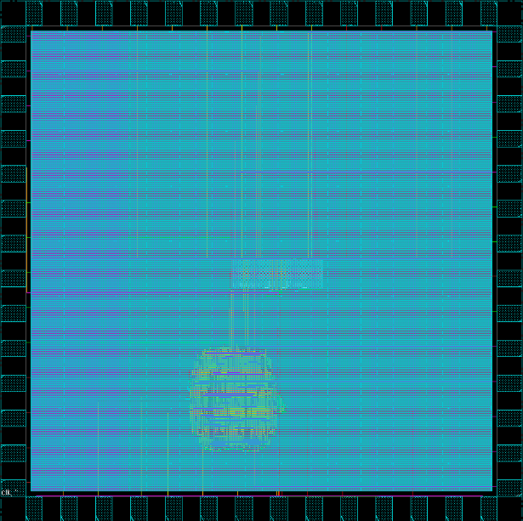
Power Grid: Global Grid
Use the addStripe command to add power stripes on high metal layers
GND
VDD
GND
VDD

Slide 24
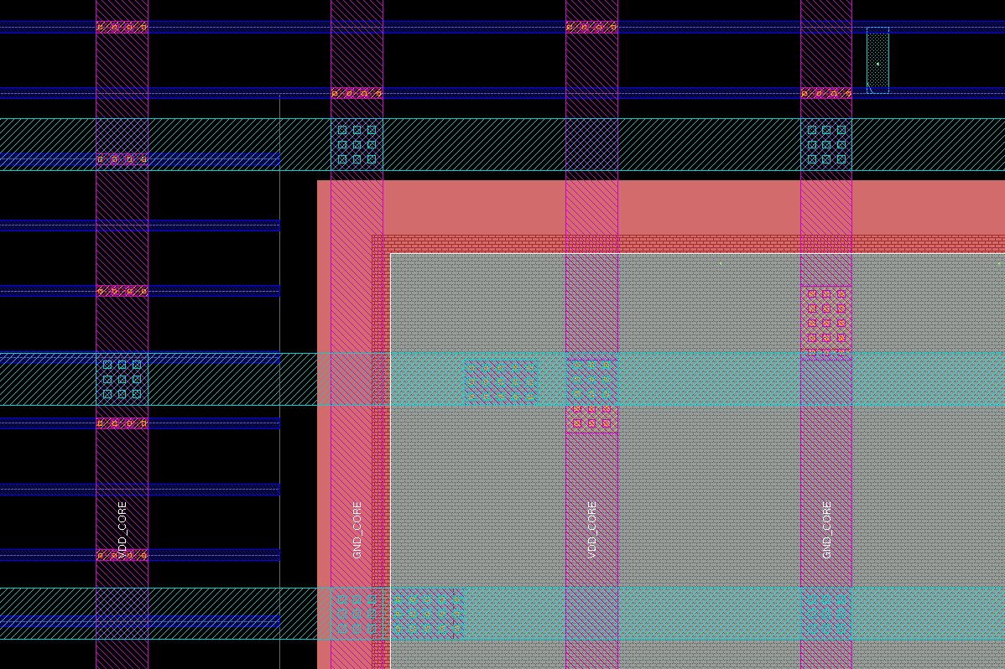
Power Grid: Rows and Macros connections
Use the editPowerVia command to add VIA down to the power pins of the standard rows and macros.
Consult the technology files (like LEF) to find out on which layer the power pins are available
PIN GND
DIRECTION INOUT ;
USE GROUND ;
SHAPE RING ;
PORT
LAYER ME3 ;
RECT 0.000 101.520 321.350 103.520 ;
RECT 0.000 1.000 321.350 3.000 ;
RECT 319.350 1.000 321.350 103.520 ;
RECT 0.000 1.000 2.000 103.520 ;
END
END GND
SRAM LEF

Slide 25
Standard Cells Placement
Quite trivial, automatically place the cells where can be
  -> placeDesign in tool
Tries to optimize timing
Floorplaning drives the placements
  I/O
  Hard macro

Slide 26



Placement constraints
Standard cells can be constraints to regions and fences
Relates to FPGA floorplaning as well (box in Xilinx ISE)
Usually not needed, sometimes useful
Guide
Region
Fence

Slide 27
Placement constraints
Fence: If you have different modules defined in your netlist you would generally prefer them to keep in a specified area where you don't want to keep other module cells. Tool neither allow other group cells to sit in that perticular fence nor allow the cells from the group out of fence.
Guide: You have the flexibility of moving the cells in and out of the design area.
Region: You could move other group cells into the region but not the region cells to out of the area.

Slide 28
Next time
Timing Configuration
Clock tree synthesis
Routing
Timing Fixes along the design flow

Slide 29
End Slide

